Slide 1

CARBON FOOTPRINT CALCULATOR
OVERVIEW
The application computes for the carbon footprint of a certain website. It also translates the computed value of carbon footprint to its equivalent carbon footprint caused by common things such as plastics, cars, people, charging smartphones, and the number of trees it would take to absorb the carbon emission of a website. The app also includes tips on how to compensate for the carbon emission caused by visiting the website.
FRAMEWORK
FEATURES
TOOLS
Node v14.9.0
IDE: Visual Studio Code
Lighthouse
Chrome-Launcher
Angular Framework
Trivia – a list of trivia/facts are being displayed when generating the report.
Comparison/Equivalent – the computed GHG of a certain website are being compared to the Co2 emission of a certain things.
Calculator – give the users the idea on what will happen if the total size of the page was decreased.
Take Action – the user will be given a tip on how to reduce the GHG of a certain website
Node v14.9.0
IDE: Visual Studio Code
Lighthouse
Chrome-Launcher
Angular Framework

Slide 2
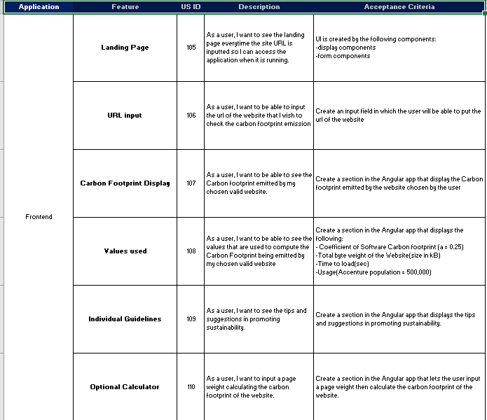
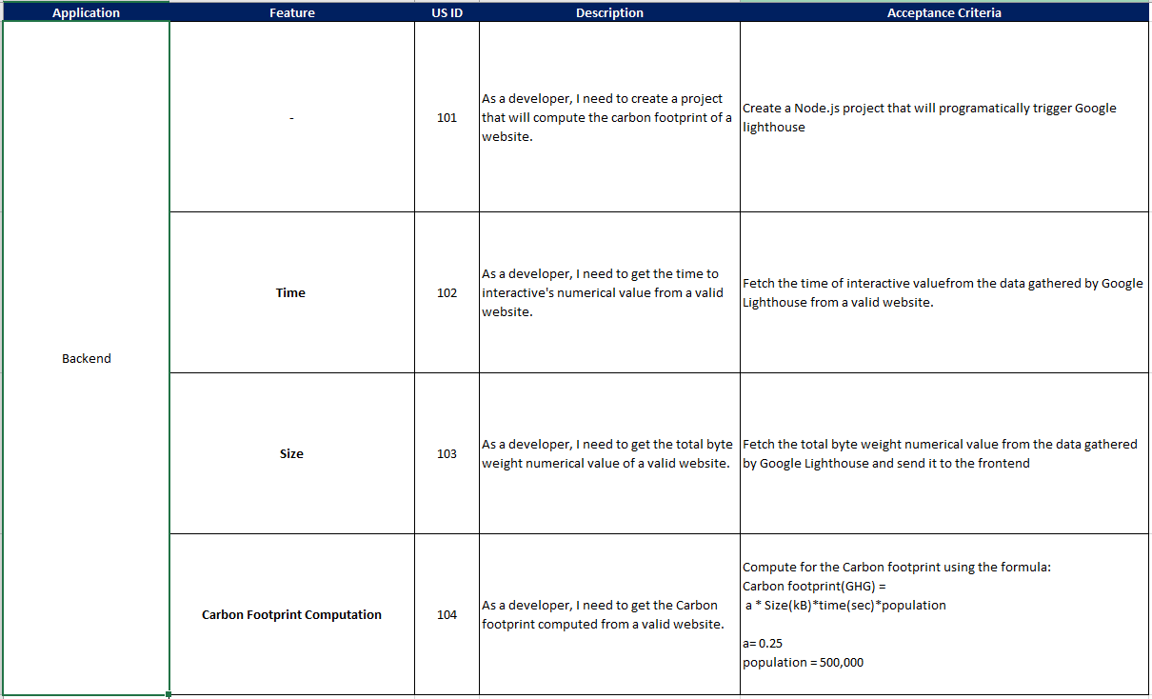
CARBON FOOTPRINT CALCULATOR
DETAILED TECHNICAL DESIGN

